Slide 1

MVOTI TO UMZIMKULU NWRCS
MVOTI & MKOMAZI RIVER ECOLOGICAL CONSEQUENCES:
Delana Louw
Rivers for Africa
26 November 201
DWA CORPORATE IDENTITY
Presented by:
Johan Maree
Deputy Director: Media Production
12 December 2012

Slide 2
Determining ecological consequences of scenarios
Need to answer the ‘what if’ questions
Express in terms of change in Ecological Category AND degree in which the REC is met
Detailed process to predict changes in all the biophysical components per site and per scenario.
Then to integrate and demonstrate in systems context
Include in MC DSS process

Slide 3
Determining ecological consequences of scenarios
Geomorphology
Geomorphology
Geomorphology
AVERAGE SCORE FOR EACH SCENARIO & STANDARDISE TO 1
Physico-chemical
Physico-chemical
Physico-chemical
Fish
Fish
Fish
Macroinvertebrates
Macroinvertebrates
Macroinvertebrates
Riparian vegetation
Riparian vegetation
Riparian vegetation
Consequences
Consequences
Consequences
EC FOR PES & REC
EC FOR SC
COMPARE EC TO REC
Evaluate scenarios
Determine PES, REC and %
Predict EC and %
Determine degree to which REC is met
Rank Scenarios at each EWR site

Slide 4
Determining ecological consequences of scenarios
RELATIVE ECOLOGICAL IMPORTANCE OF SITES
PES
EIS
Locality in conservation areas
Confidence
Length of river
WEIGHT
Ecological ranking of scenarios per EWR site
APPLY WEIGHT TO
OUTPUT
Ecological ranking of scenarios for the system

Slide 5
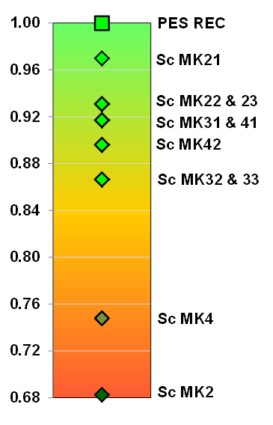
MKOMAZI RESULTS: MK_1_EWR
Geomorp: Impact of the dam on sedimentation and possible erosion and accumulation of fines.
Results in habitat changes.
Lack of fast flowing habitats and possible reduction and/or eradication of ANAT and BNAT (Sc 2&4 – no EWR)
Scenarios that include EWR releases are an improvement, but the unseasonal releases and at times higher flows than natural are problematic.
Most scenarios meet the ecological objectives in terms of EcoStatus except for Sc MK4 and MK2 (no EWR)
None of the scenarios meet the ecological objectives for all the components. Sc Mk 21 are the best of the options overall and is therefore ranked the highest
Proposed Smithfield Dam
MK_I_EWR 1
MK_I_EWR 2
C
MK_I_EWR 3
C/D
Sappi
Estuary
D

Slide 6
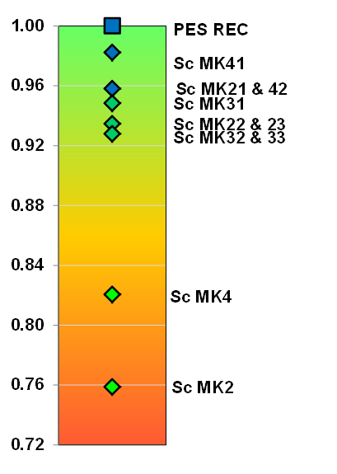
MKOMAZI RESULTS: MK_2_EWR
Geomorp: Impact of the dam on sedimentation and possible erosion and accumulation of fines.
Results in habitat changes.
The other scenarios include increased high flows in the dry season with a loss of slow habitats which impact on fish.
None of the scenarios meet the ecological objectives. Although Sc MK21, 41 and 42 results in the same EcoStatus, the instream biota are impacted by the reduced wet season base flows and reduced floods. Sc MK41 is the best scenario of these three scenarios because it provides more flows during wet season.
Scenario MK2 and MK4 have the worst impact due to reductions in baseflows during dry and wet seasons.
B
Proposed Smithfield Dam
MK_I_EWR 1
B/C
MK_I_EWR 2
C
MK_I_EWR 3
Sappi
Estuary

Slide 7
MKOMAZI RESULTS: MK_3_EWR
Geomorp: Less severe impacts than us.
Deterioration in instream biota (small), is related to the low flows for drought in wet months and impact on spawning
Sc MK 21, 31 and 41 result in the same EcoStatus and have the least impact with a slight deterioration in geomorphology and instream biota.
Sc MK22, 23, 32 and 33 also have the same EcoStatus as the PES/REC but there is further deterioration in the instream biota as well as geomorphology and water quality.
Scenario MK2 and 4 have the biggest impact as overall they drop a category for while Sc MK42 only caters for the low flow EWR and the impact is therefore slightly less, i.e. it drops half a category
Proposed Smithfield Dam
MK_I_EWR 1
C
MK_I_EWR 2
C/D
MK_I_EWR 3
Sappi
D
Estuary

Slide 8
MKOMAZI RIVER: INTEGRATED CONSEQUENCES
Where the line crosses, the ranking order between sites are different.
To determine a system ranking, need to weigh the sites

Slide 9
MKOMAZI RIVER: SITE WEIGHTING
Proposed Smithfield Dam
EWR site | PES | EIS | Conf | Locality in protected areas | Dist | Normalised Weight
EWR 1 | C | Moderate | 3.4 | 1 | 0.08 | 0.22
EWR 2 | B | High | 3.5 | 3 | 0.32 | 0.37
EWR 3 | C | Moderate | 3.4 | 1 | 0.6 | 0.41
MK_I_EWR 1
MK_I_EWR 2
MK_I_EWR 3
Sappi
Estuary

Slide 10
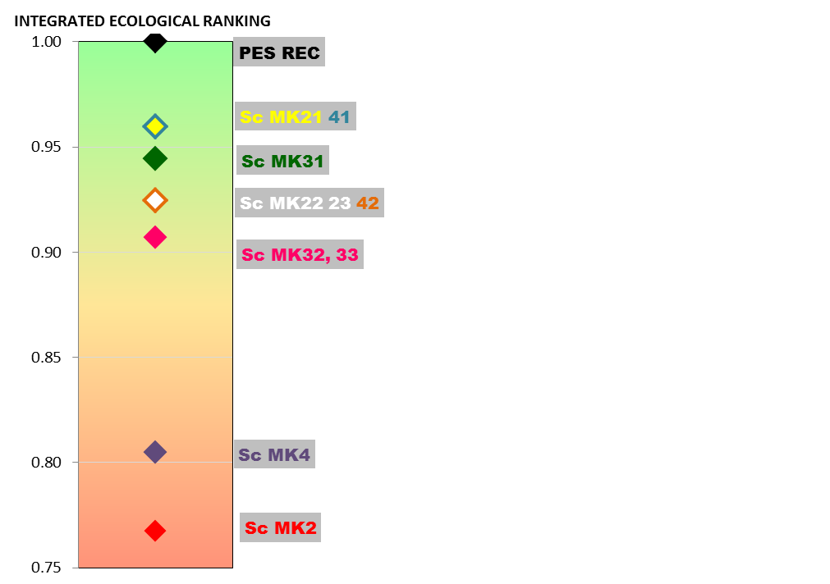
MKOMAZI RIVER: INTEGRATED RANKING
Sc MK 21 and 41 are the best options as they are the closest to meeting the ecological objectives.
Both these scenarios include the total EWR flows and the impacts are mostly due to the impacts on the dam itself, such as the barrier effect, impact on larger frequency of floods and largely due to the increased (above natural) base flows.

Slide 11
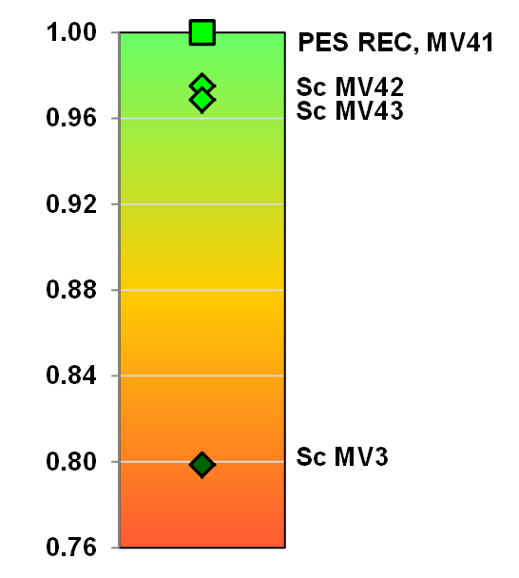
MVOTII RESULTS: MV_I_EWR2
Sc MV3 is the worst case as it does not include EWR releases. The channel will narrow with vegetation encroachment. An overall loss of fast habitats will impact on the instream biota.
Impacts associated with Sc MV42 and 43 are less pronounced as it includes EWR releases to some degree.
Sc MV 41 supplied the total EWR and therefore meets the ecological objectives.
C
D

